Slide 1
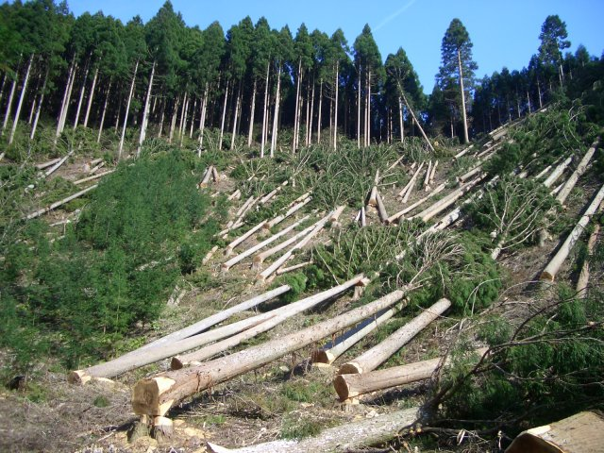
Deforestation
Team Nimbus
Michael T., Anu P., Anthony S.

Slide 2
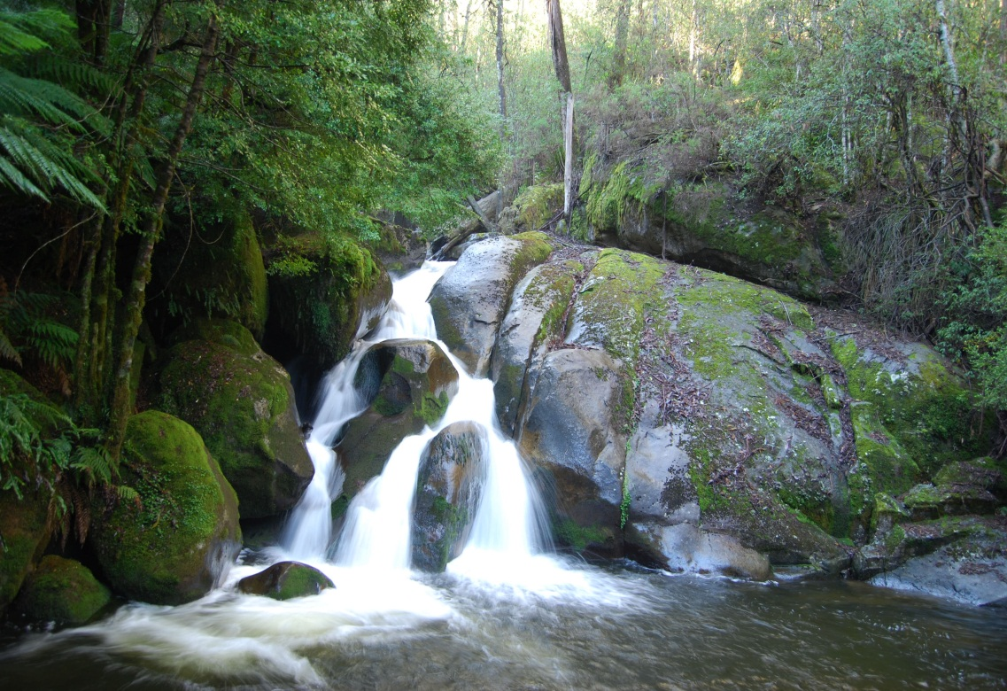
The 4 Spheres
Biosphere
Atmosphere

Slide 3
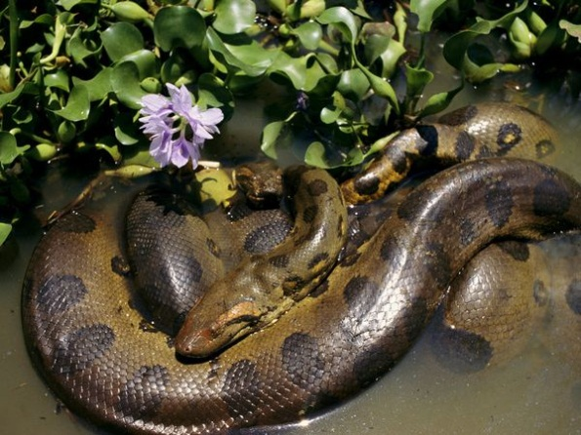
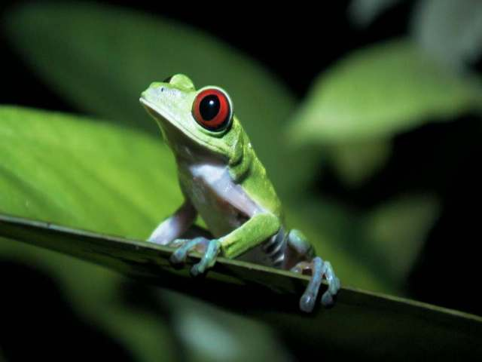
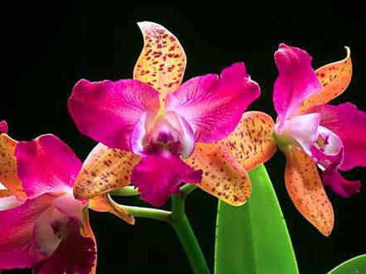
The Environmental Problem
Animals and plants depend on the rainforest
Humans cut down the forest to make room for farming

Slide 4
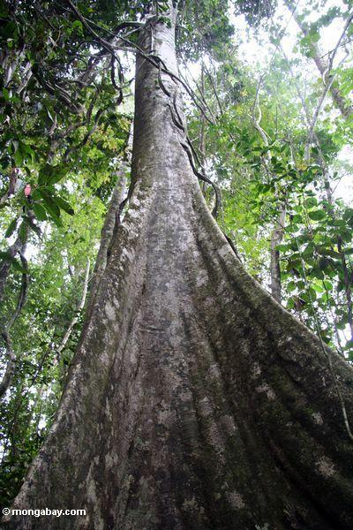
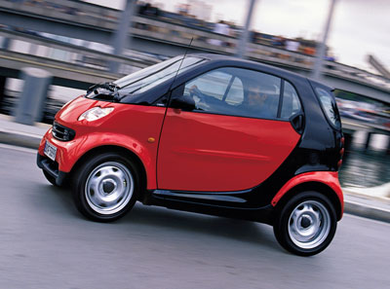
The Environmental Problem
Some plants in the rainforest can cure diseases
Trees absorb carbon dioxide

Slide 5
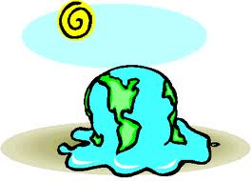
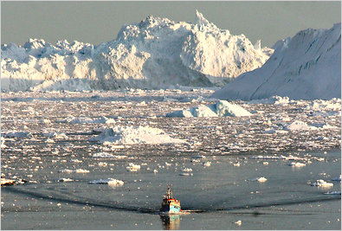
Human Impact
Humans are impacted by this because we need trees to survive. Trees provide oxygen and raw materials like wood. Trees also absorb carbon dioxide, which will help the growing problem of global warming

Slide 6
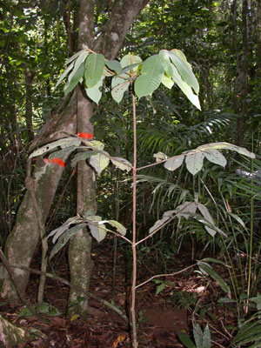
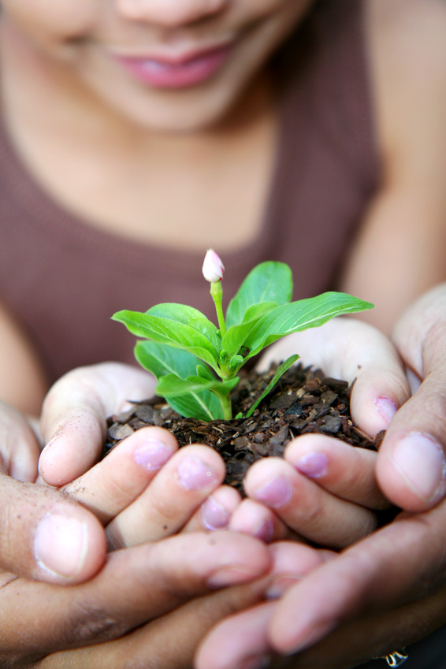
Summary
Many people are working to prevent deforestation by planting more trees and working hard to make laws that prevent this growing problem
People are working to make the environment clean and green.

Slide 7
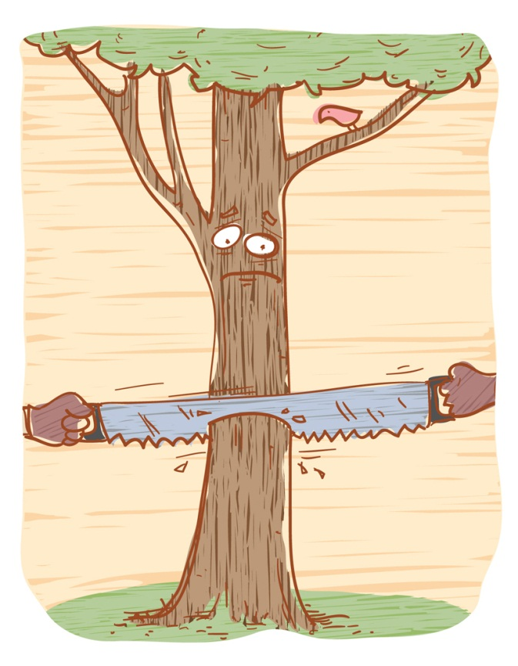
Resources
http://photos.mongabay.com/07/virola_sebifera_sapling.jpg
http://www.google.com/imghp?hl=en&tab=ii&safe=active

Slide 8
THE END

