Slide 1
Tokyo Fault line
Anu Pandit
Michael Thornton

Slide 2
Location
Japan
North American & Pacific Plates
Major cities: Tokyo
Millions of people live on or near the fault

Slide 3
Convergent
North American & Pacific Plates are colliding into each other
Earthquakes, volcanoes, tsunamis and mountains
Moving 1.3-1.5 inches per year

Slide 4
Features
Earthquakes
Thousands of small earthquakes every year
Tremors happen every five minutes in Japan

Slide 5
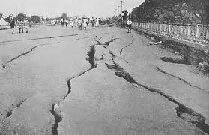
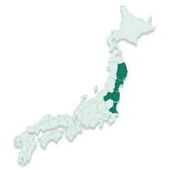
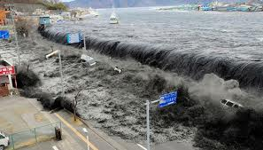
Major Tectonic Events
Great Kanto Earthquake:
Date : September 1st 1923
Magnitude: 7.9
Duration : 4minutes
140,000 deaths and 447,000 houses destroyed.
Facts:
This 2011 undersea earthquake occurred in the north-western Pacific Ocean at a relatively shallow depth of 32 km (19.9 mi)
The earthquake, caused by 5 to 8 meters up thrust on a 180-km wide seabed at 60 km offshore from the east coast of Tōhoku, resulted in a major tsunami that brought destruction along the Pacific coastline of Japan's northern islands. The tsunami also caused number of nuclear accidents.
Great Kanto earthquake was the deadliest earthquake in Japanese history, and at the time was the most powerful earthquake ever recorded in the region. Because the earthquake struck at lunchtime when many people were cooking meals over fire, many people died as a result of many large fires that broke out.
A strong typhoon also struck Tokyo Bay at about the same time as the earthquake.
Great Eastern Earthquake: Date :
Friday March 11,2011
Magnitude: 9.0
15,870 deaths
6,114 injured
129,225 houses destroyed

Slide 6
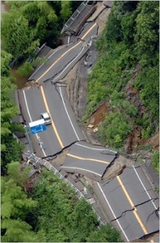
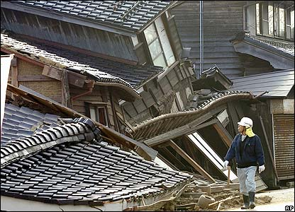
Impact of the Tokyo Fault line
A recent earthquake hit northeastern Japan putting stress on Tokyo Fault line
Highly populated, a big earthquake, such as a 7.5 would be devastating for Tokyo

Slide 7
Resources
http://www.popularmechanics.com/science/environment/natural-disasters/why-japans-massive-earthquake-surprised-scientists-5382984
http://www.boston.com/news/world/asia/articles/2011/03/22/fault_line_pressure_now_closer_to_tokyo/
http://en.wikipedia.org/wiki/2011_T%C5%8Dhoku_earthquake_and_tsunami#Damage_and_effects
http://en.wikipedia.org/wiki/1923_Great_Kant%C5%8D_earthquake

